Slide 1
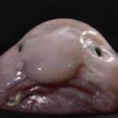
My interests
By MEEEEE

Slide 2
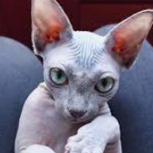
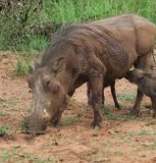
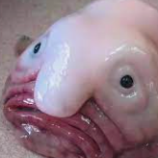
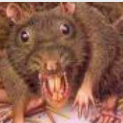
Animals
I love all animals even the ugly ones such as rat's warthogs blob fish and hairless cats.

Slide 3
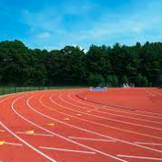
Running
I do little aths and in that I do most of the long-distance events such as 800 meters 400 meters and In winter I like to do 2000 meters and 3000 meters.

Slide 4
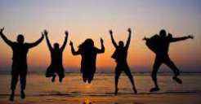
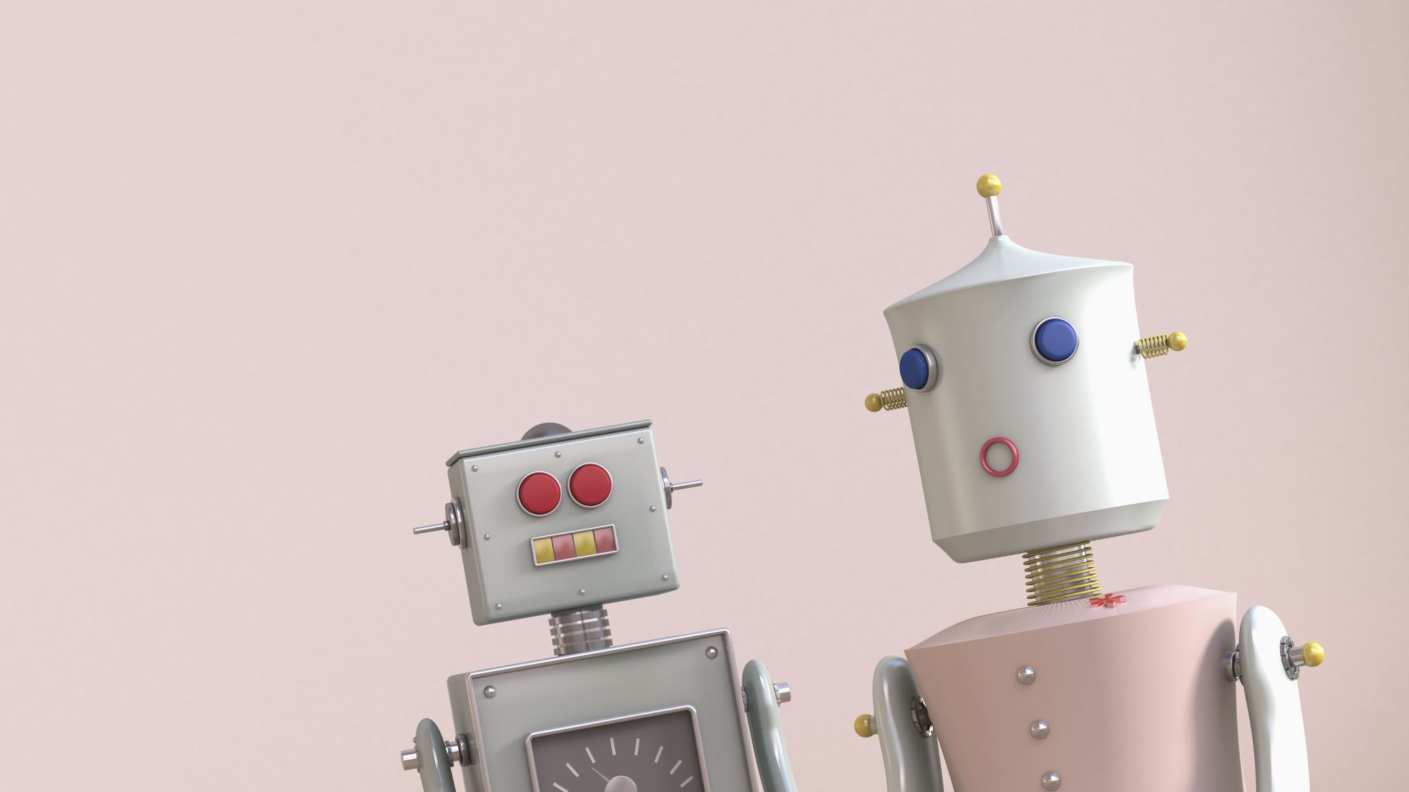
My friends
I love all my friends such as Evie kk charlotte H Eva Remi Sophie Annabel and many more people.

